Slide 1
Project Overview

Slide 2
Hello !
We are GROUP 16
Github: https://github.com/chalovina/Group16/tree/master/Group16_MppProject
Demo Video: https://www.youtube.com/watch?v=DoL4I_s_dPo

Slide 3
All features are implemented (including extra optional parts)
Login
Checkout
Add copy
Add library member
Add book
Search and print checkout entry record
Search and print overdue checkout

Slide 4
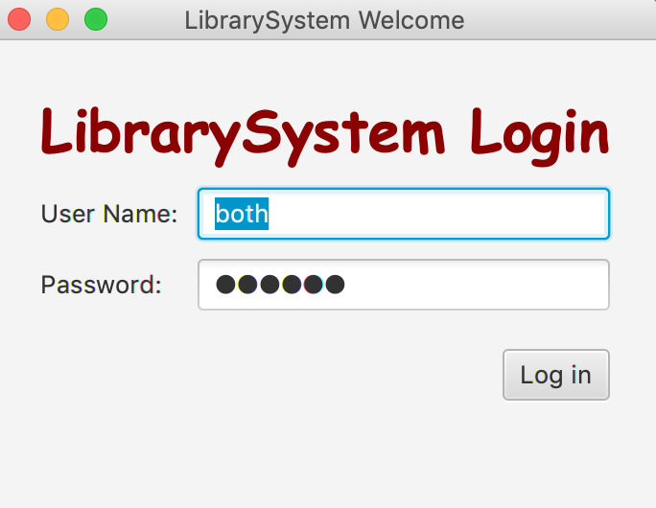
1.LOGIN
Difference roles: Super Admin: both
Admin: admin
Librarian: lib

Slide 5
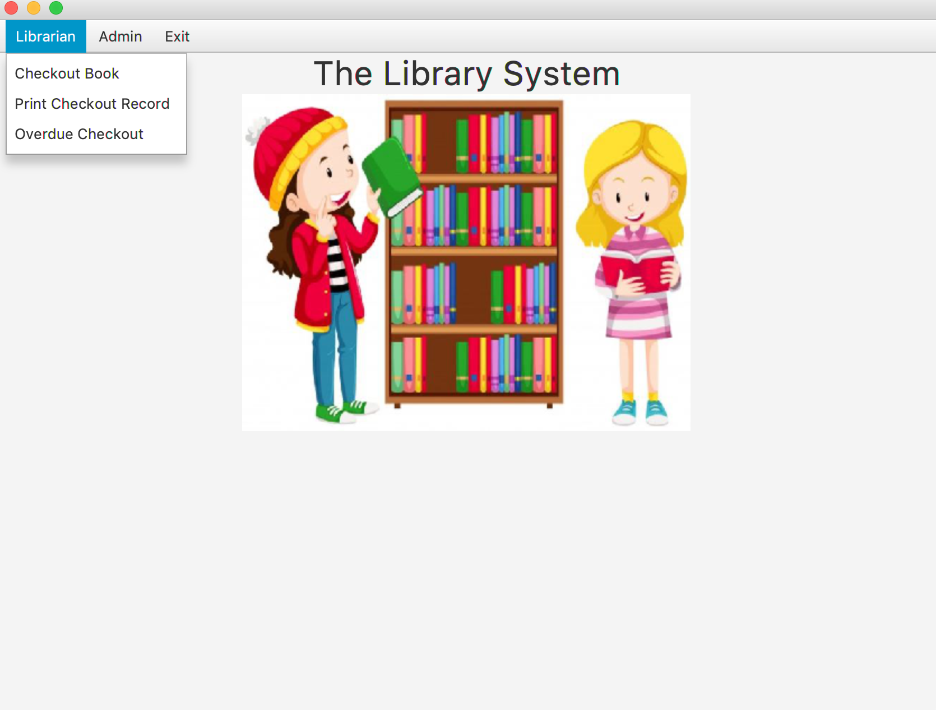
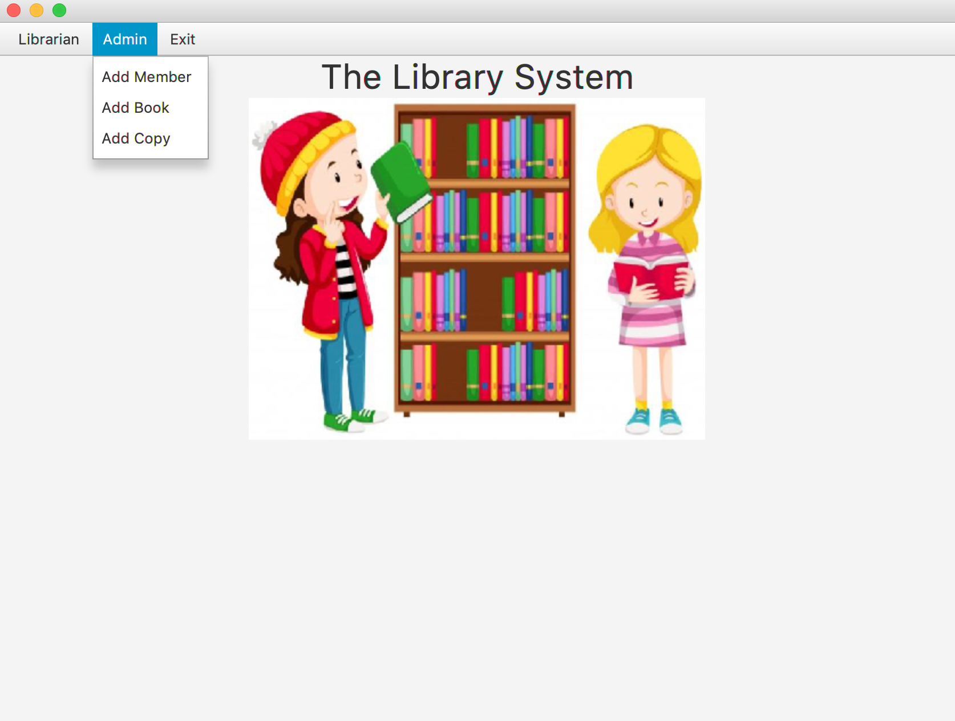
Super admin view
Super admin has fully permission for role: Admin and Librarian

Slide 6
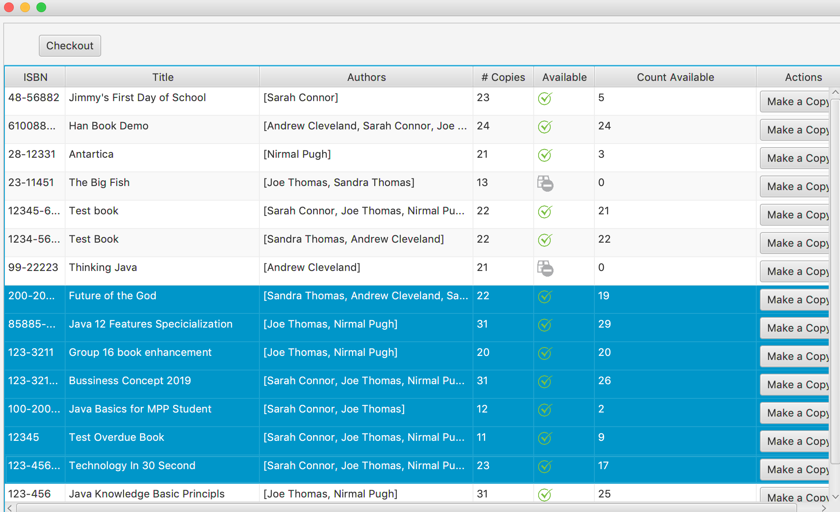
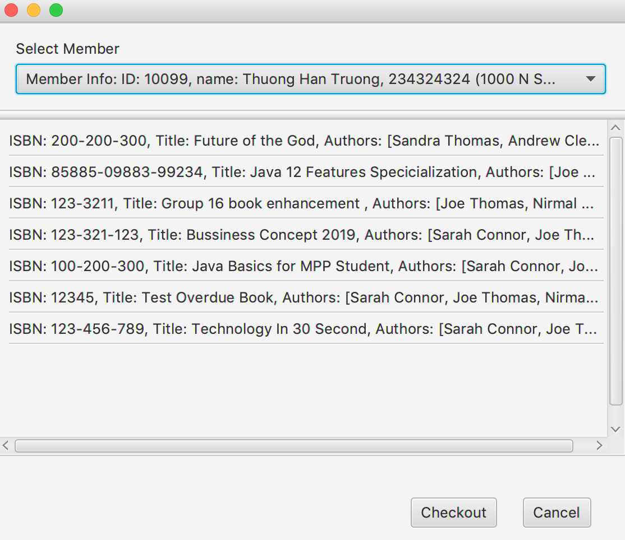
Checkout, Make a copy and more

Slide 7
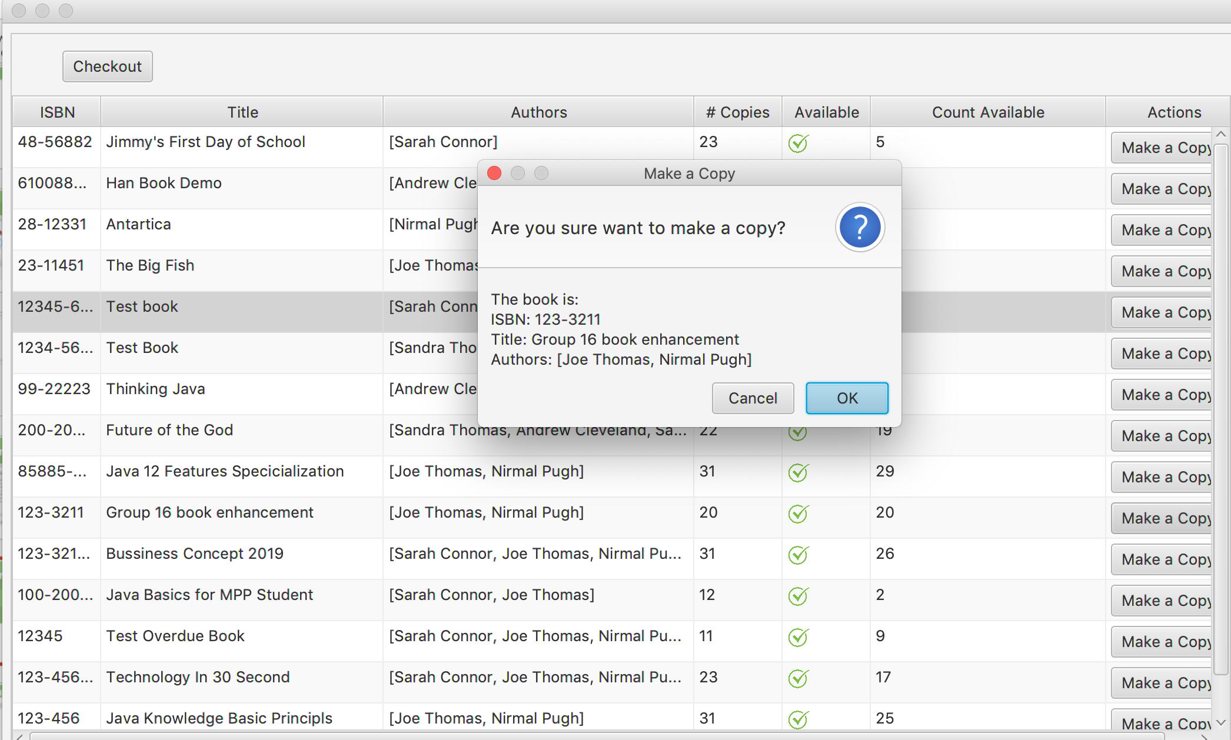
Checkout, Make a copy and more

Slide 8
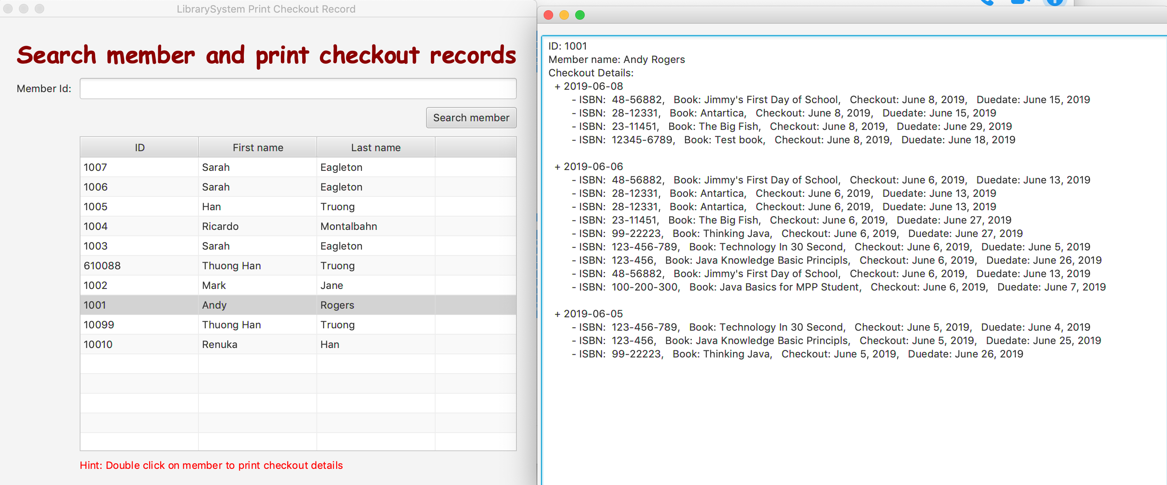
Search member and print checkout records

Slide 9
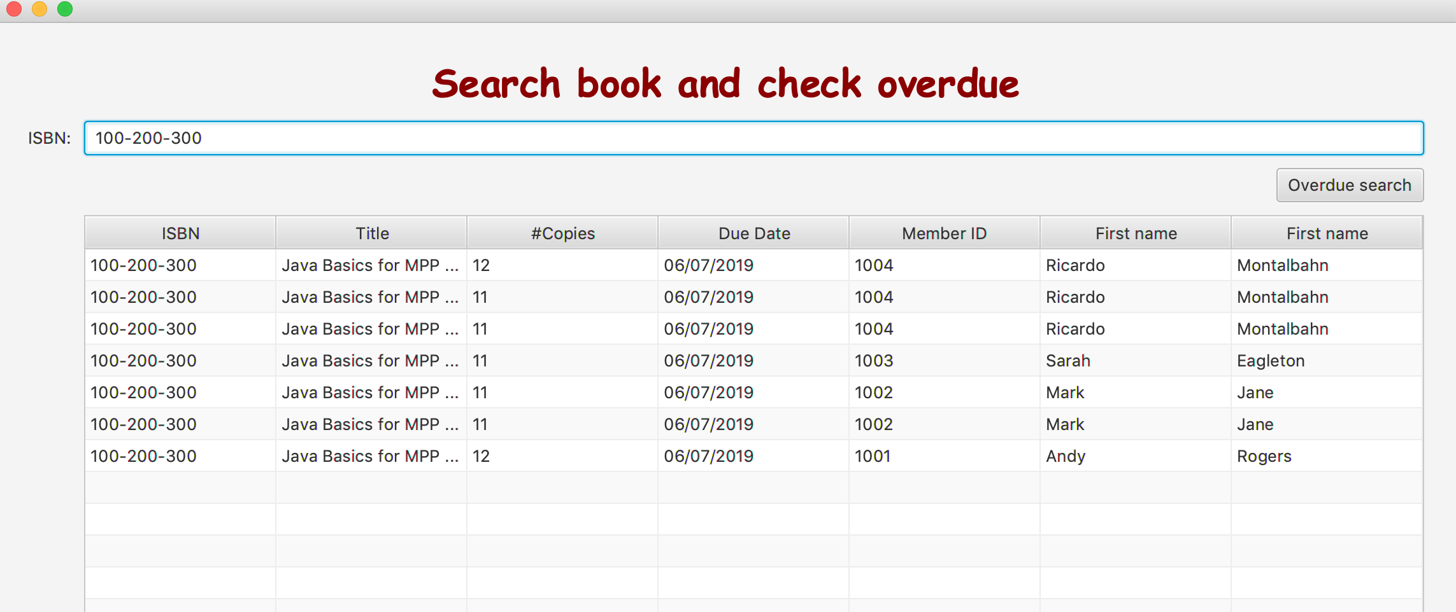
Search member for overdue

Slide 10
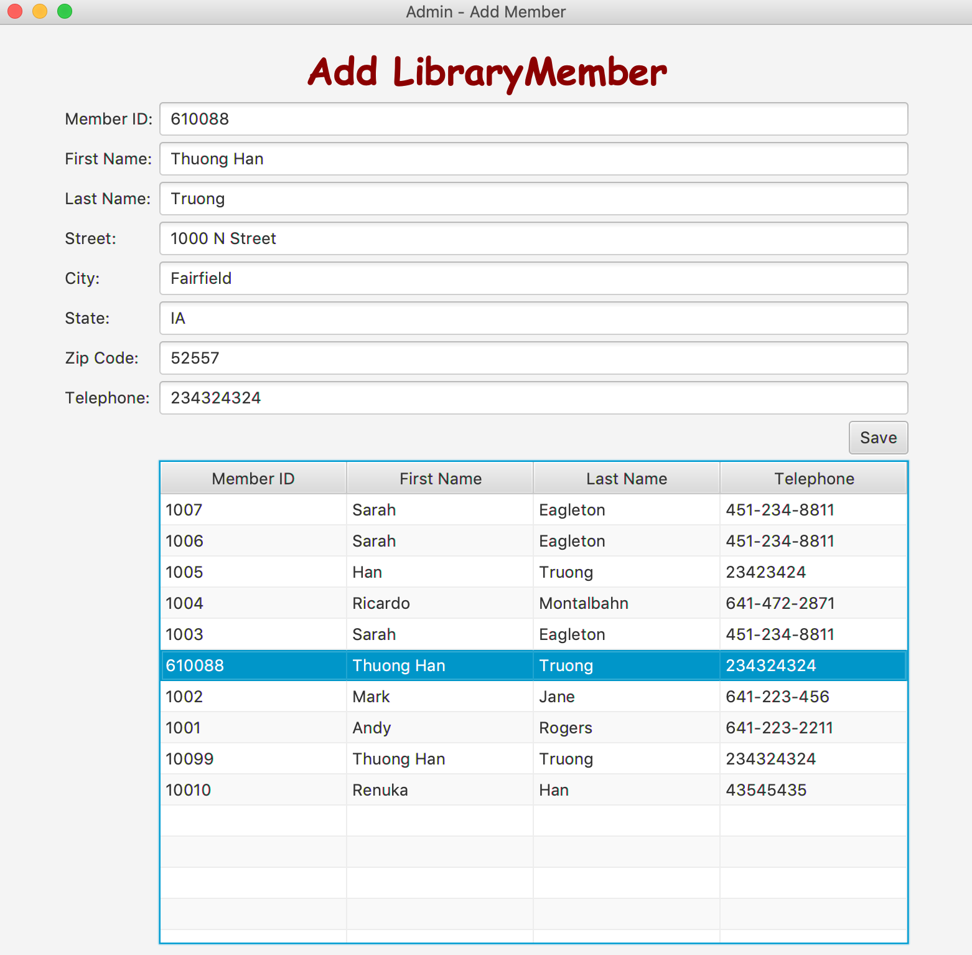
Add library member

Slide 11
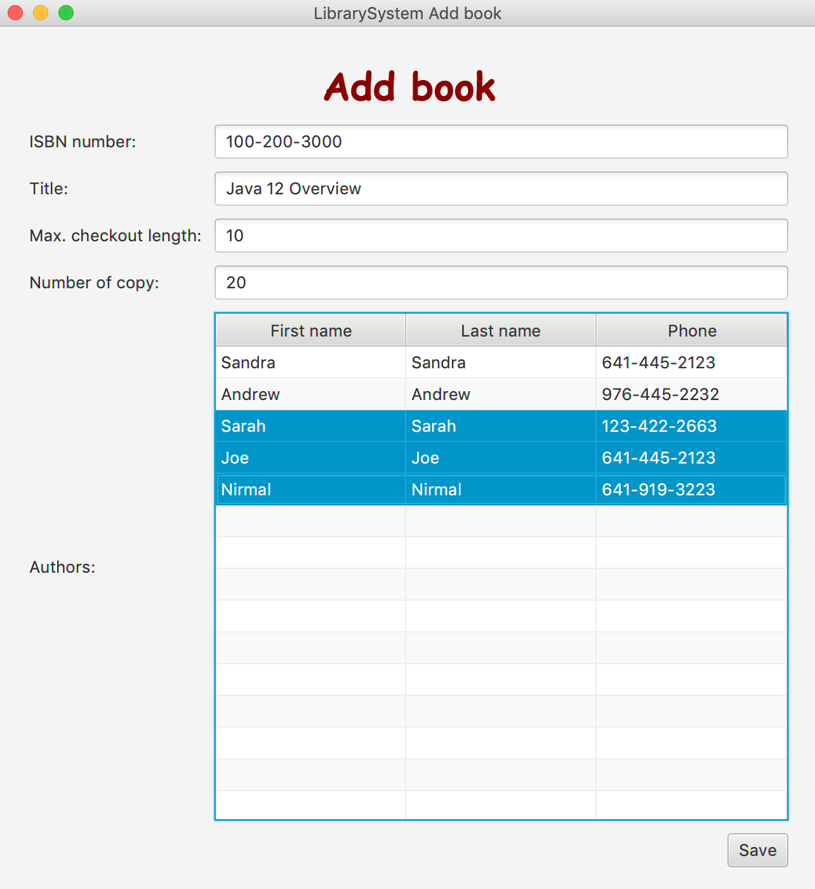
Add book

Slide 12
SCI knowledge
Knowledge is structured in consciousness. Transcendental Consciousness is the simplest state of awareness and consciousness, where the mind goes beyond thoughts and concepts to the most abstract level of awareness – the "abstract content" of awareness.
The “simplest” association is the relationship of pure consciousness to itself; this can also be modeled with an arrow from pure consciousness to itself. The pure consciousness is the field of all possibilities, the source of all solutions.
Whole is contained in every part and wholeness moving within itself: In Unity Consciousness, one recognizes that the relationship of the Self to the Self is not only fundamental, but is in reality the only relationship there is.

